Slide 1
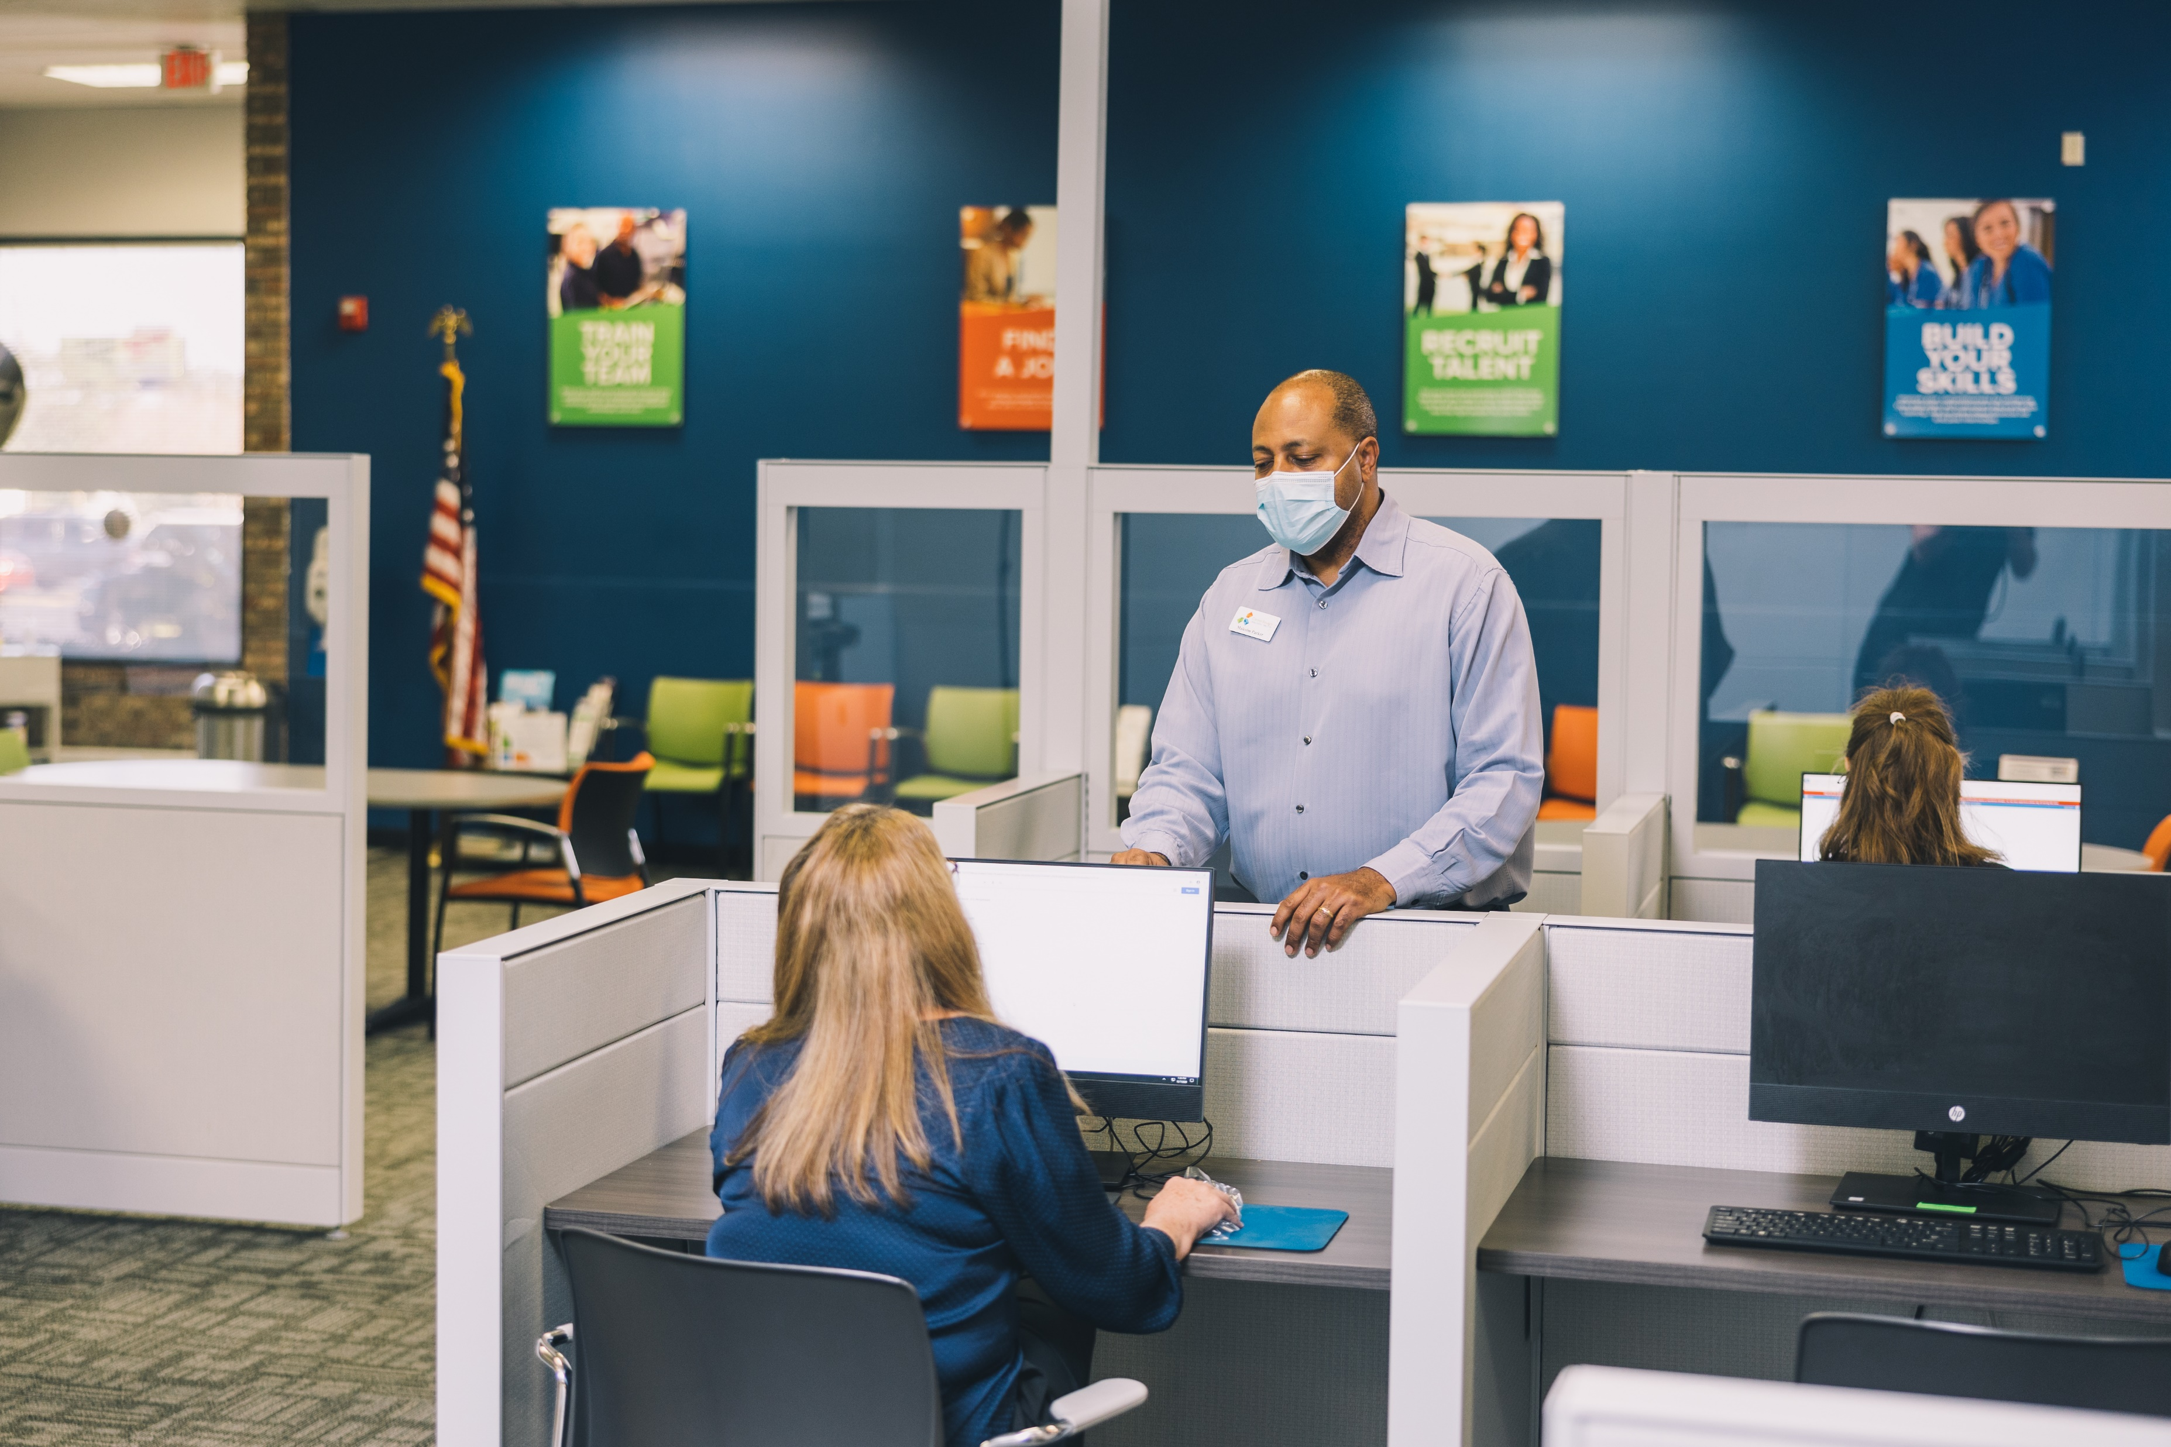
CareerSource Okaloosa Walton
Notes:
Aligns with CSF’s mission
Role: develop strategies to support our mission and coordinate the activities of the members of the BS team
Team: 7 staff members. This includes 2 LVERS whose main focus is to advocate for the hiring of veterans. 1 COMPLIANCE Specialist to keep us on track with program requirements and local Veteran Coordinator who keeps us abreast with veteran matters

Slide 2
The Value
Notes:
Aligns with CSF’s mission
Role: develop strategies to support our mission and coordinate the activities of the members of the BS team
Team: 8 staff members. This includes 3 LVERS whose focus is to advocate for the hiring of veterans. 1 COMPLIANCE Specialist to keep us on track with program requirements and local Veteran Coordinator who keeps us abreast with veteran matters

Slide 3
The Value
TALENT PIPELINE
Value/Benefits:
Reduce Hire Cost
Increase Retention
Increase Productivity & Performance
Minimize Turnover Rate
Universal
Individual with Disability
RESEA
Veterans
Military Spouses
TSM
WIOA Adult/ Youth
Registered Apprenticeship Participants
The Talent Pipeline: Workforce as an asset for regional prosperity
Notes:
The value we add to our businesses in the community is unique and can be better described by three benefits we offer: 1) Talent pipeline we generate/created. This involves all the programs available at CSOW working towards helping individuals get work ready (universal clients, veterans and WIOA graduates). Our Business Services team is instrumental for the delivery of the talent to businesses in the community. We roughly save businesses between $400 to 1200 in hiring cost.

Slide 4
The Value
INDUSTRY
ACCOUNT MANAGER
(aka SMEs)
TARGET INDUSTRY SECTORS
Aerospace/Aviation & Tech
Healthcare and Social Assistance
Manufacturing
Construction
Public Administration
The Talent Pipeline: Workforce as an asset for regional prosperity
Notes:
The second benefit we offer is our knowledge. We have account managers aka SMEs that understand not only a unique business’s needs but industry needs. This helps us craft solutions for to impact not only 1 business but businesses within an industry sector facing similar workforce challenges.

Slide 5
The Value
Economic Development Partners
Military Installations
TCPI
CareerSource Florida
Veterans Florida
Building Industry Association (BIA)
SHRM
Northwest Florida Manufacturing Council
O2O
ASUS
HBI
Education Partners
NETWORK
The Talent Pipeline: Workforce as an asset for regional prosperity
Notes:
The 3rd benefit we offer is our network. “We know people”.

Slide 6
Recruitment

Slide 7
Recruitment
Providing specialized candidate searches and providing quality referrals
Facilitating job fairs and hiring
Events (Virtual and In-Person)
JOB POST
Promoting job vacancies in our daily newsletter and on our social media
Notes:
By creating an account in Employ Florida and listing open requisitions with CSOW, our staff can help with your recruitment efforts by:
Providing specialized candidate searches and providing quality referrals;
Facilitating job fairs and hiring events;
Promoting your job vacancies in our daily newsletter and on our social media

Slide 8
Recruitment
DoD SkillBridge
Executive TAP
TAP/Pre-Separation Briefings
AFRC Referrals
Out of State Recruitment Campaign
LinkedIn
Military Family Employment Program is the best in FL
VETERANS AND TRANSITIONING MILITARY
SKILLED PROFESSIONALS
MILITARY SPOUSES
ACCESS TO SKILLED TALENT

Slide 9
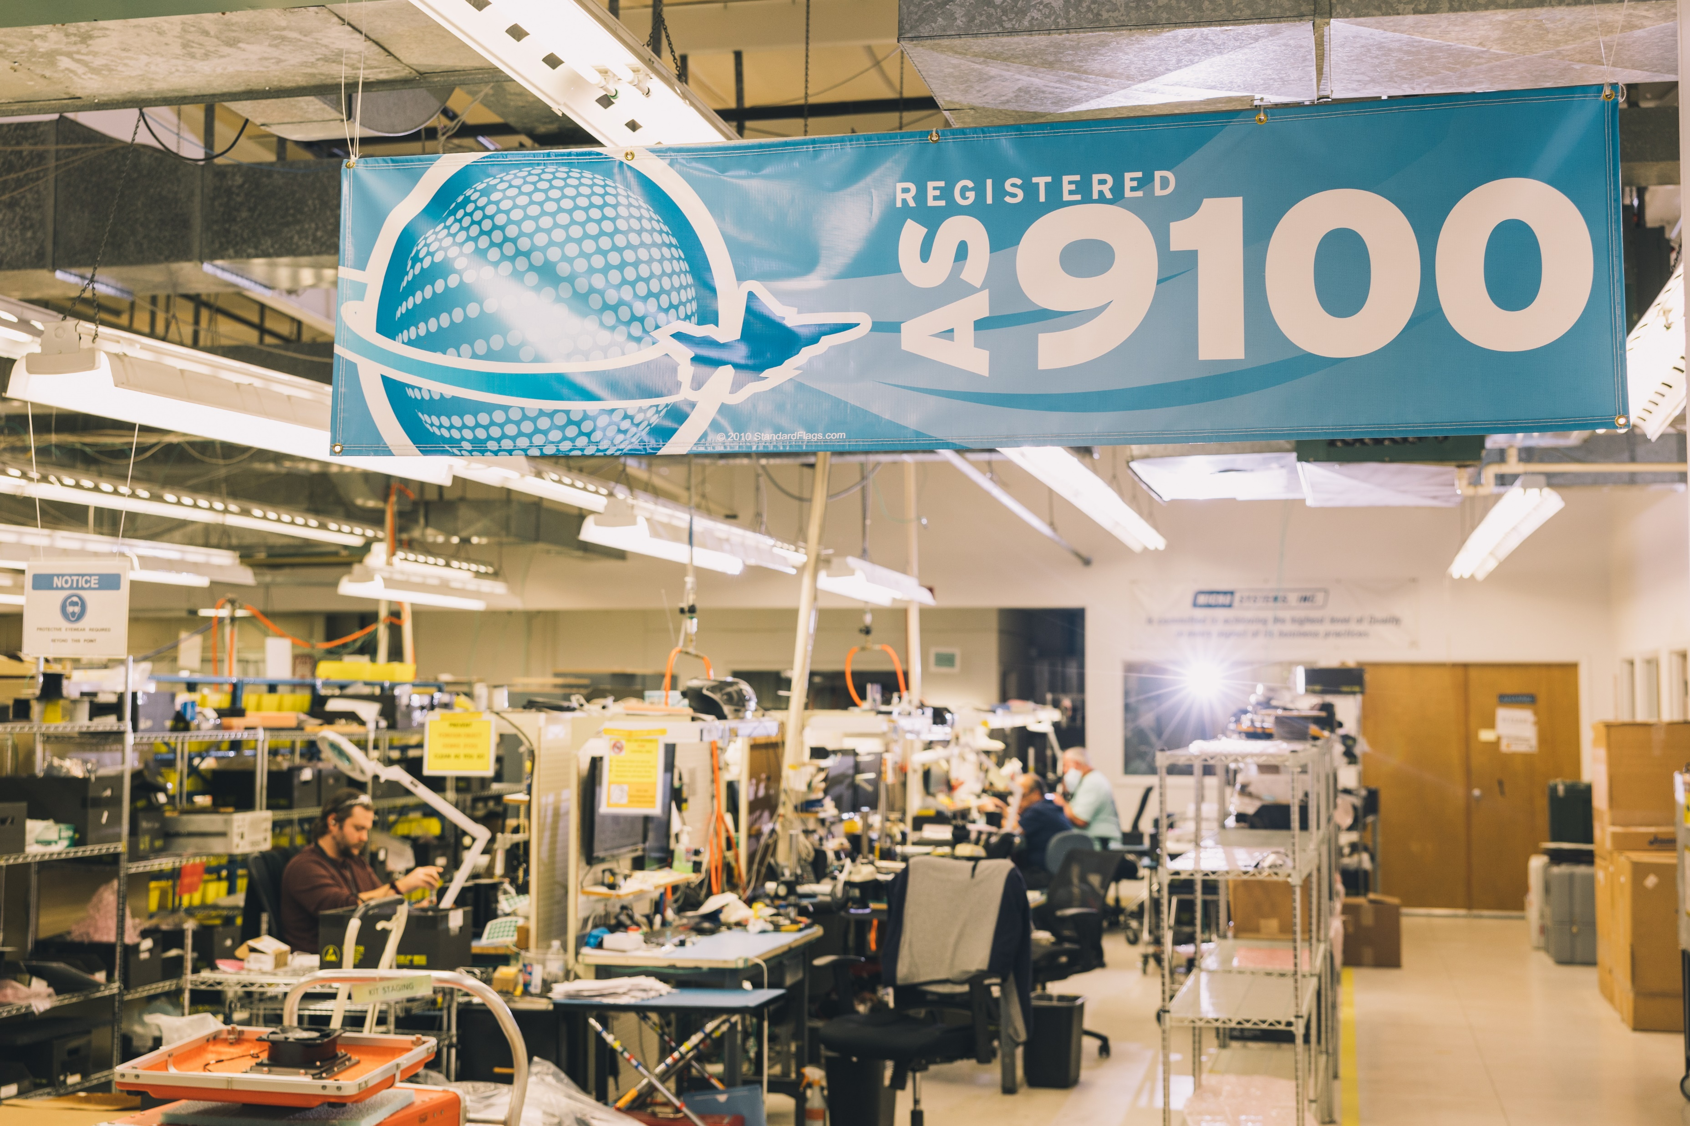
Training Funds

Slide 10
Training Funds
QUICK RESPONSE TRAINING
Funded through CareerSource Florida
The Quick Response Training program provides grant funding for customized, skills-based curriculum development and training, through partial reimbursement, to new or expanding businesses in Florida’s targeted industries
Typically, Quick Response Training includes the following reimbursable expenses:
A portion of instructors’/trainers’ salaries
Curriculum development,
Textbooks/manuals,
Customized, skills based online training,
Travel for trainers or trainees and other costs.

Slide 11
Training Funds
INCUMBENT WORKER TRAINING (IWT)/ EMPLOYED WORKER TRAINING (EWT)
Provides grant funding for continuing education and training of incumbent employees at existing Florida businesses.
Companies may receive a reimbursement rate up to 50 percent.
Tuition/training/course cost and/or instructors’ wages capped at:
$35/hour for company employees delivering the training,
$200/instructor hour for vendor training

Slide 12
Training Funds
ON THE JOB TRAINING
Provides knowledge or skills essential to the full and adequate performance of the job. Candidate must meet eligibility requirements cannot begin employment until OJT contract and registration are complete.
Provides reimbursements to the employer of up to 50% of the wage rate of the participant to off-set the costs of providing training and the additional supervision related to the training of a new hire.
Duration of training is dependent on the occupation skill gap.

Slide 13
Training Funds
VETERANS FLORIDA
The Veterans Florida Workforce Grant is available to Florida businesses seeking to train and hire military veterans.
The program helps businesses meet workforce demands in a competitive environment by facilitating access to training and education in high-demand fields for veterans through matching training grants.
Matches up to $8,000.00 per full-time veteran.
Senate Bill 586 ISO DoD SkillBridge initiative.

Slide 14
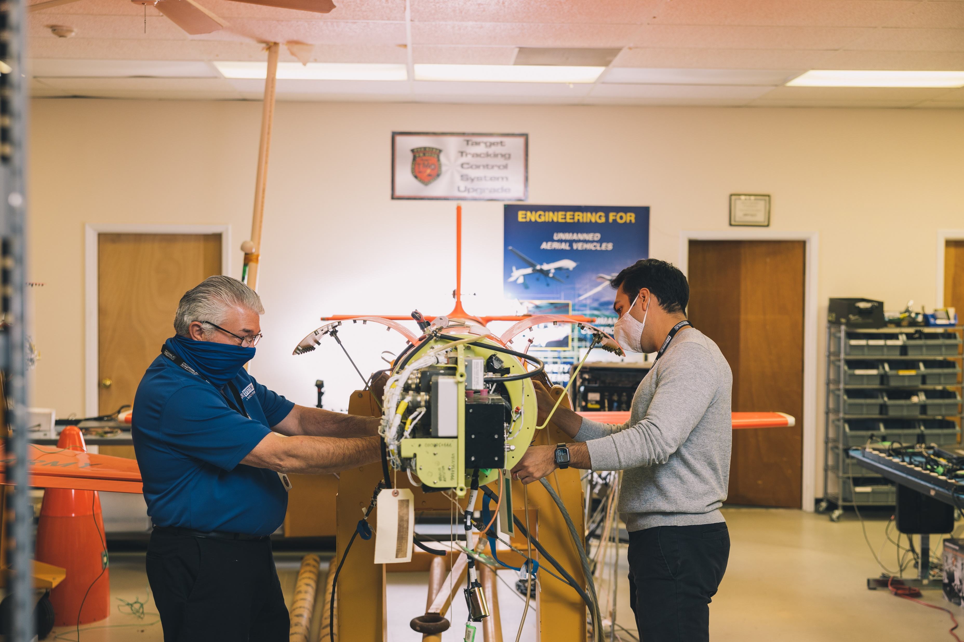
DoD SkillBridge

Slide 15
DoD SkillBridge
SkillBridge is an opportunity for Service members to gain valuable civilian work experience through specific industry training, apprenticeships, or internships during the last 180 days of military service prior to separation.
72 Transitioning Service Members have gained employment due to CSOW facilitated SkillBridge internship in the past 2 years.
Currently working with over 40 TSMs stationed across the world who are looking for internships in Okaloosa and Walton counties.
Employment is not promised through participation, but there must be a high probability of post-service employment.
Employers operating on a military installation must have a MOU to participate.

Slide 16
DoD SkillBridge
838 TSMs in Northwest Florida (Hurlburt Field/Eglin AFB) transitioning this calendar year in the following career fields:
HURLBURT, EGLIN AND TYNDALL REPRESENT 67.58% OF FLORIDA’S VETERANS SEPARATING OR RETIRING

